Slide 1
Predicting Obesity from Lifestyle Characteristics of Latin American Population
Group: Runtime TError
Members: Halie Nguyen, George Cedeño,
Pooja Aryamane

Slide 2
Objective of the Study
Analyze
Select Features
Model
Analyze the distribution of key lifestyle characteristics in a sample population of Peru, Colombia, and Mexico using visualizations and summary statistics.
Explore the impact of demographic, eating & exercise habits on obesity level using hypothesis testing.
Predict obesity level given a certain set of lifestyle characteristics.

Slide 3
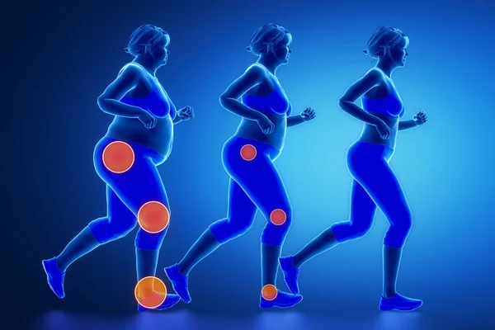
Obesity
Obesity is understood as abnormal or excessive fat accumulation that presents a risk to health and it is a complex condition. Eating habits, physical activity levels, and individual characteristics are a few of the many variables that may lead to excessive weight gain.

Slide 4
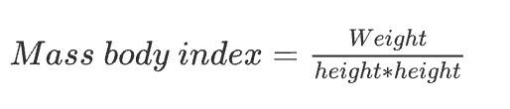
Data Description
Data was obtained from UC Irvine Machine Learning Repository
16 attributes and one Target with 2,111 records
Target Outcome: Obesity Levels
Calculated using “Mass Body Index” and comparing it to the data provided by WHO and “Mexican Normativity” to create the subclasses.
Reference: Palechor FM, Manotas Ade. Dataset for estimation of obesity levels based on eating habits and physical condition in individuals from Colombia, Peru and Mexico. Data in Brief. 2019;25:104344. doi:10.1016/j.dib.2019.104344
Category | Mass Body Index
Underweight | <18.5
Normal | 18.5-24.9
Overweight | 25.0-29.9
Obesity I | 30.0-34.9
Obesity II | 35.0-39.9
Obesity III | >40

Slide 5
Eating Habit Related Attributes
Attribute Name | Attribute Description
FAVC | Frequent consumption of high caloric food
FCVC | Consumption of vegetables
NCP | Number of main meals
CACEC | Consumption of food between meals
CH2o | Consumption of water daily
CALC | Consumption of alcohol
SMOKE | Smoking behavior

Slide 6
Physical Condition Related Attributes
Attribute Name | Attribute Description
SCC | Calories Consumption Monitoring
FAF | Physical Activity Frequency
TUE | Time Using Technology Devices
MTRANS | Transportation Used

Slide 7
Demographic & History Variables
Attribute Name
Gender
Age
Height
Family History
Weight

Slide 8
Methodology
Exploratory Analysis
Feature Selection
Data Pre-processing
Modeling
Interpreting Feature Importance
Study feature distribution (Pandas, Matplotlib, Seaborn)
Hypothesis testing (Pandas, SciPy, Sklearn)
Preparing the data (Pandas, Sklearn)
Logistic Regression (Sklearn)
Interpreting features that impact obesity (Sklearn, Seaborn)

Slide 9
Exploratory Data Analysis
01
Summary statistics & visualizations

Slide 10
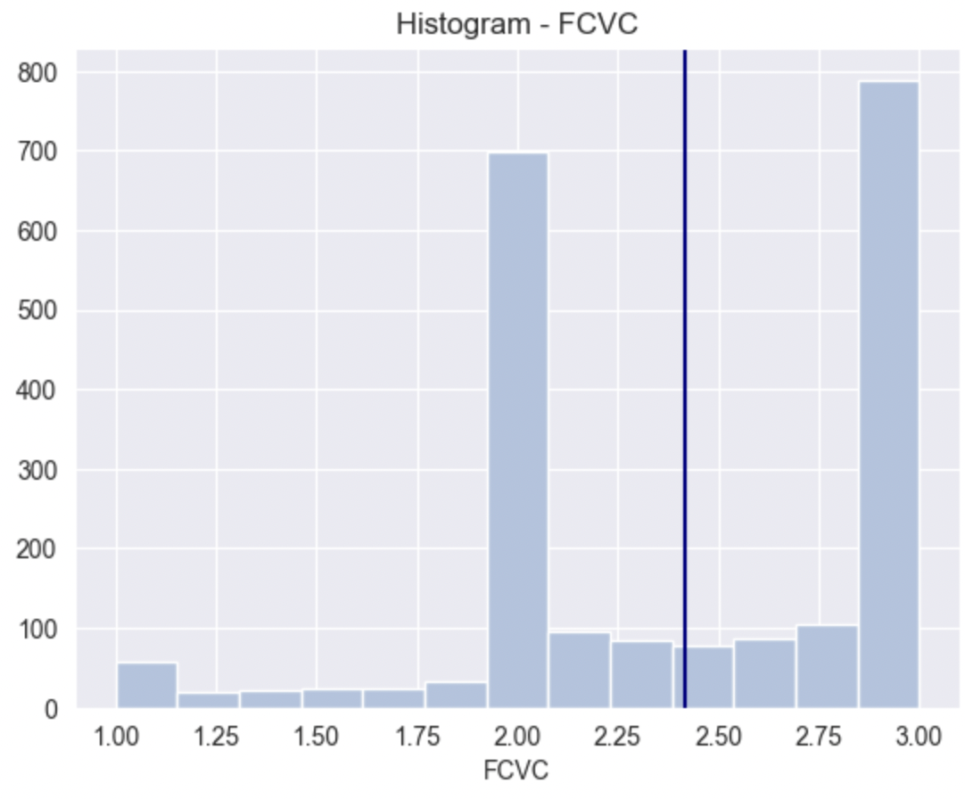
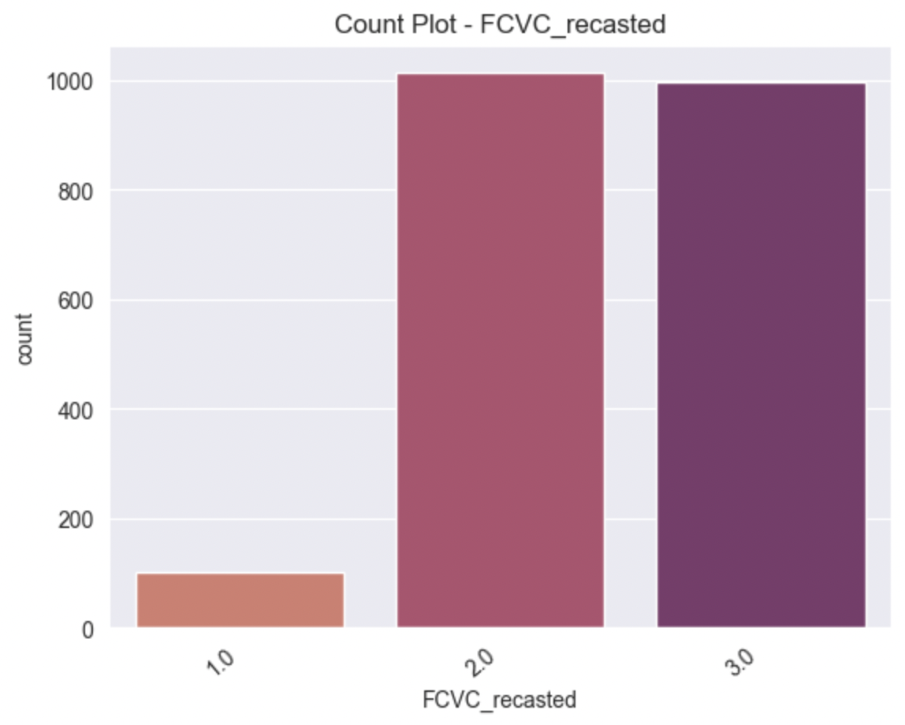
Data Validation
FCVC - Consumption of Vegetables: Never, Always, Sometimes

Slide 11
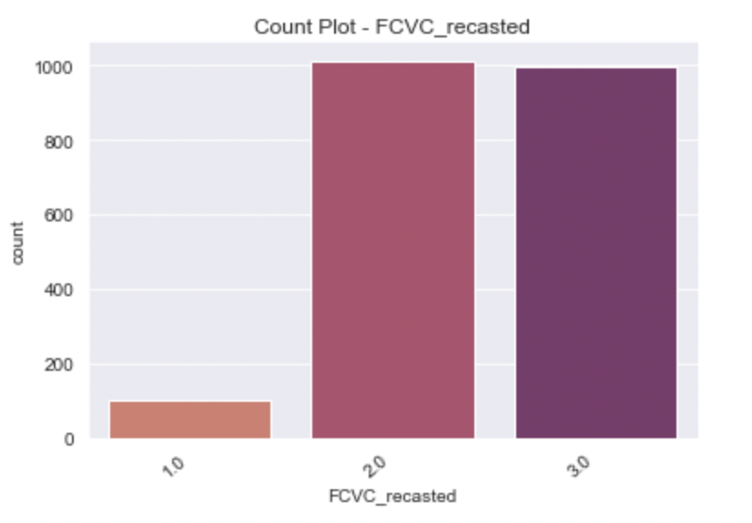
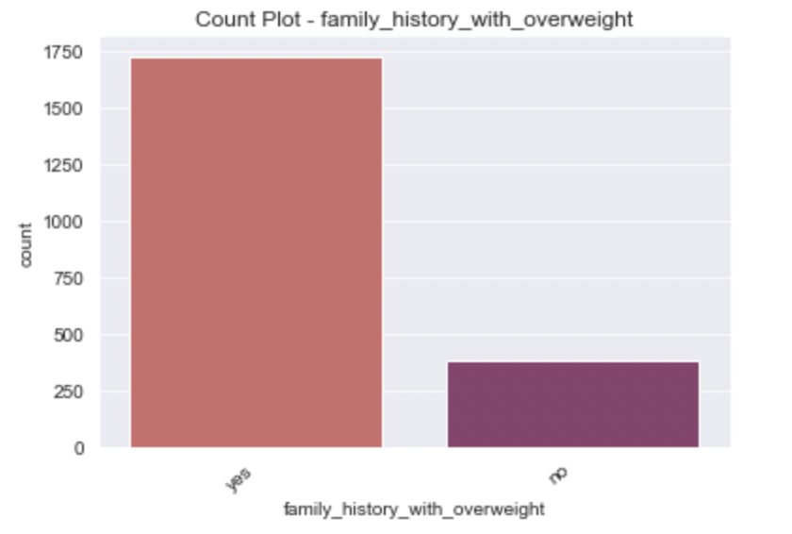
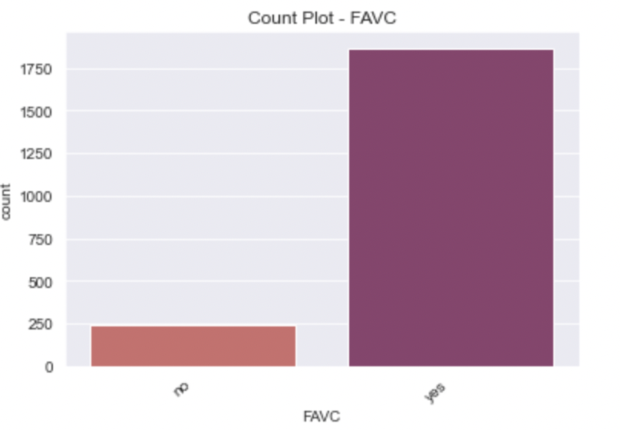
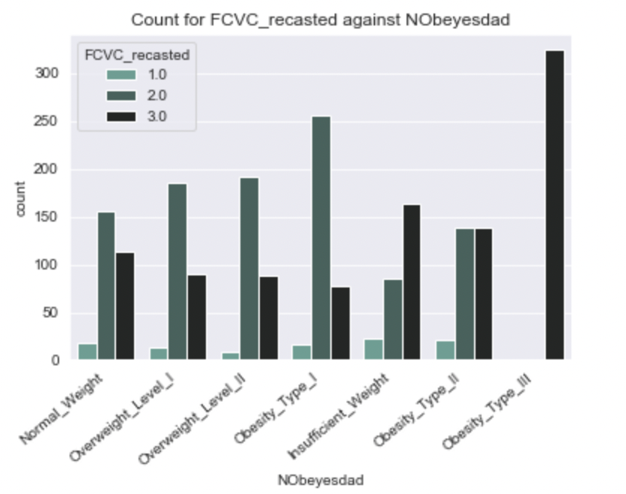
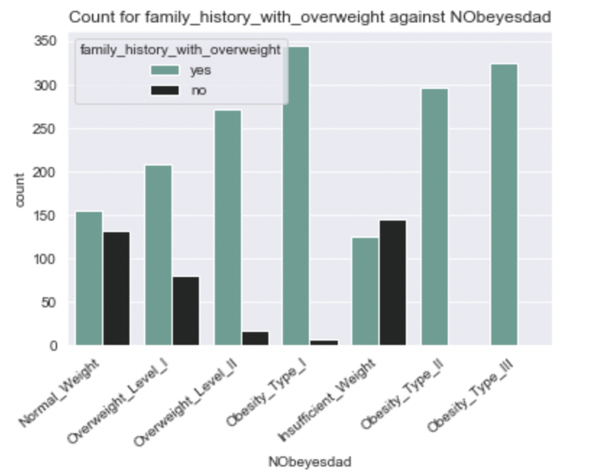
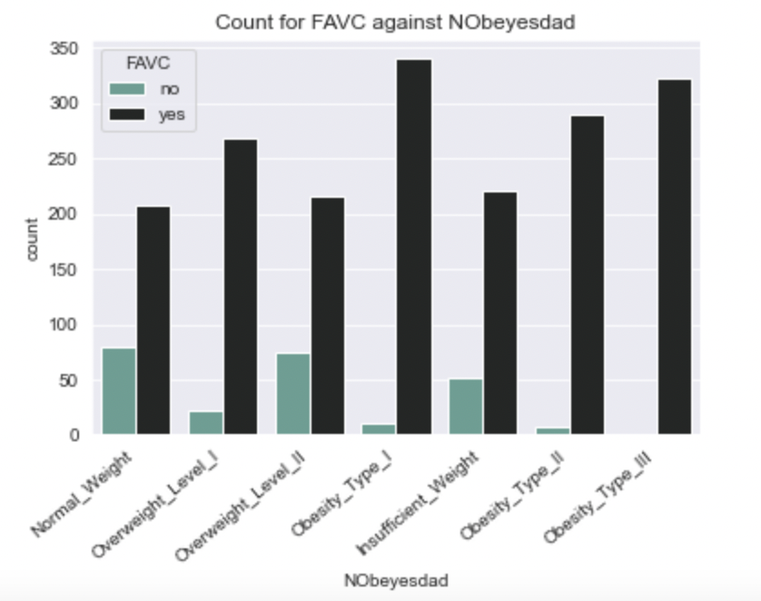
Categorical Features
Frequent Consumption of Vegetables:
0: Never
1: Sometimes
2: Always
Family History with Overweight:
Yes
No
Frequent Consumption of High Caloric Foods:
0: Yes
1: No
Notes:
FCVC - Frequency of consumption of vegetables
family_history_with_overweight - Family history with overweight
FAVC - Frequent consumption of high caloric food

Slide 12
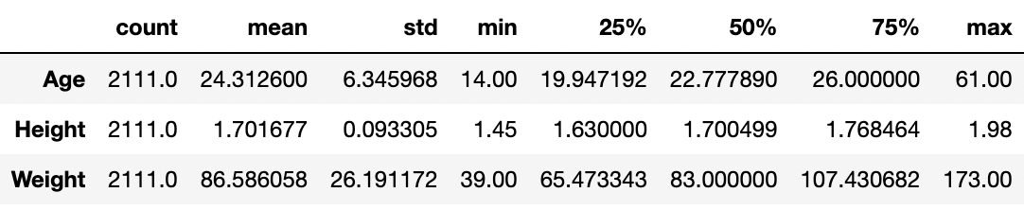
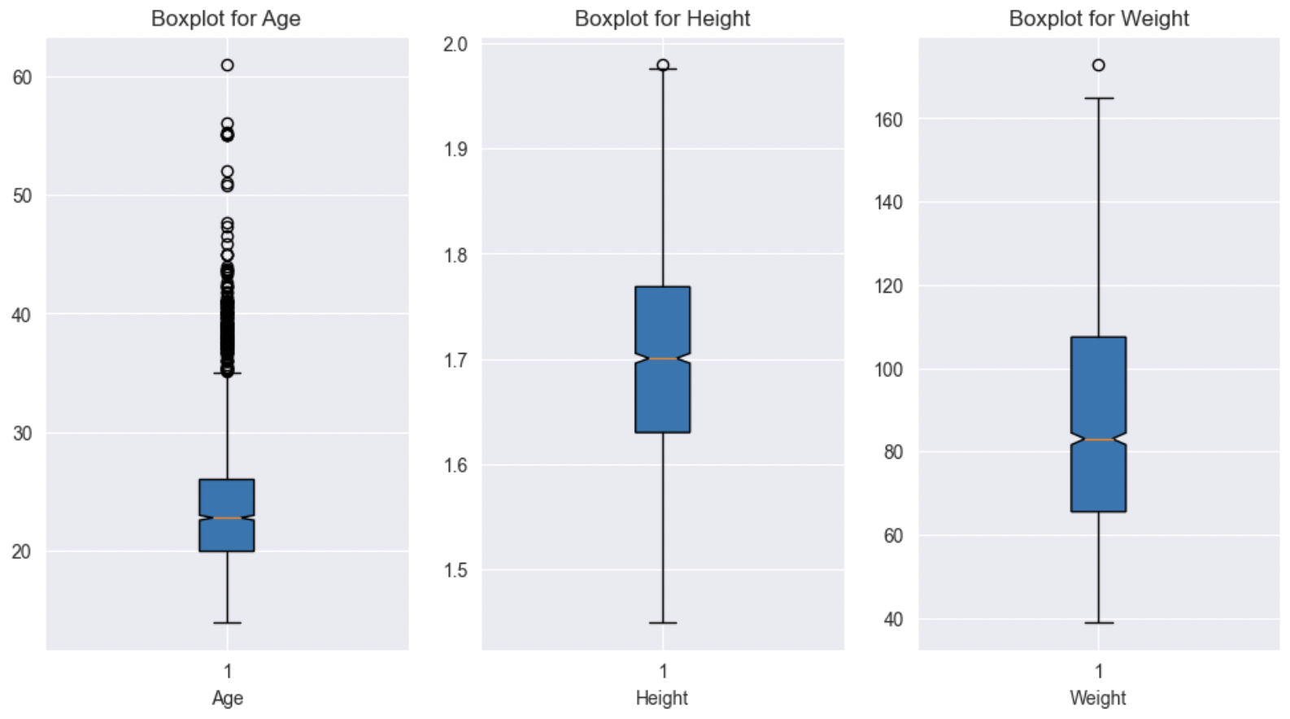
Numeric Features - Univariate

Slide 13
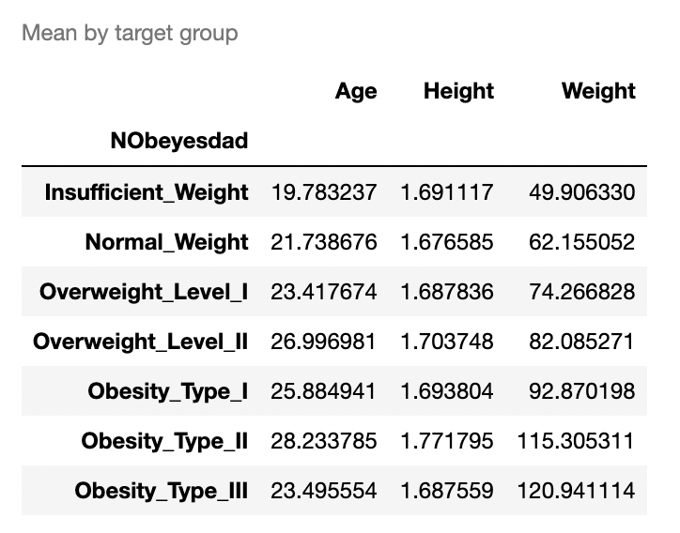
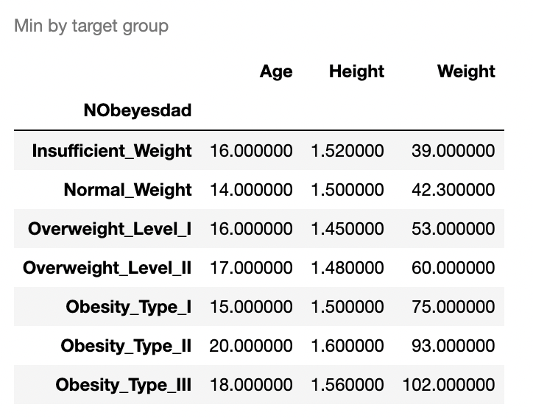
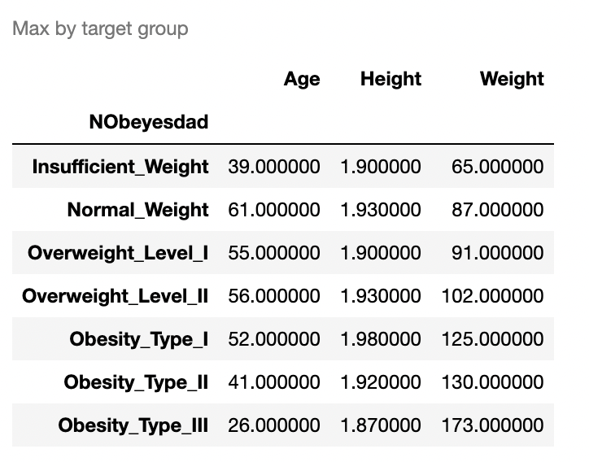
Numeric Features - Bivariate Summary Statistics

Slide 14
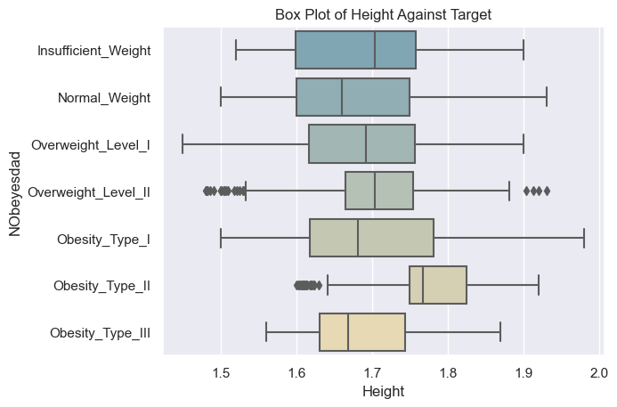
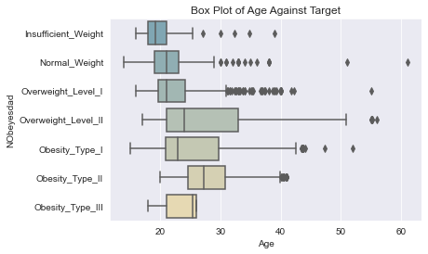
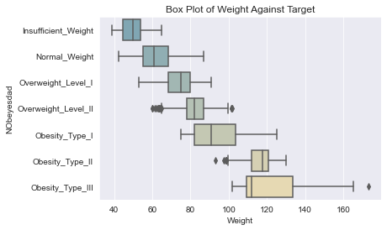
Numeric Features - Bivariate Visualization
Histograms for each distribution
Bivariate comparisons
Boxplots for inter-quartile range & outliers

Slide 15
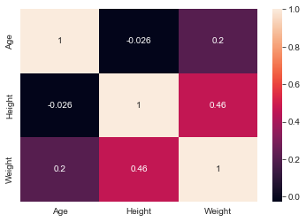
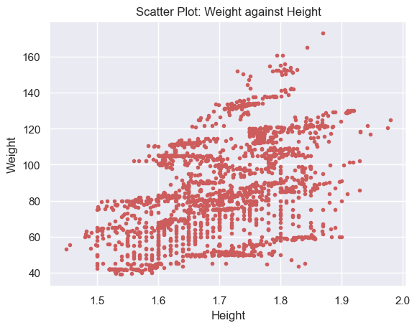
Important Findings
We observed a positive relationship between weight and obesity, as expected, but no clear relationship between height, age, and obesity
There appeared to be some positive correlation between weight and height, but not very significant.

Slide 16
Data Pre-processing
02
Preprocessing for hypothesis testing
Notes:
Preprocess data in preparation for hypothesis testing on the relationship between predictors and target

Slide 17
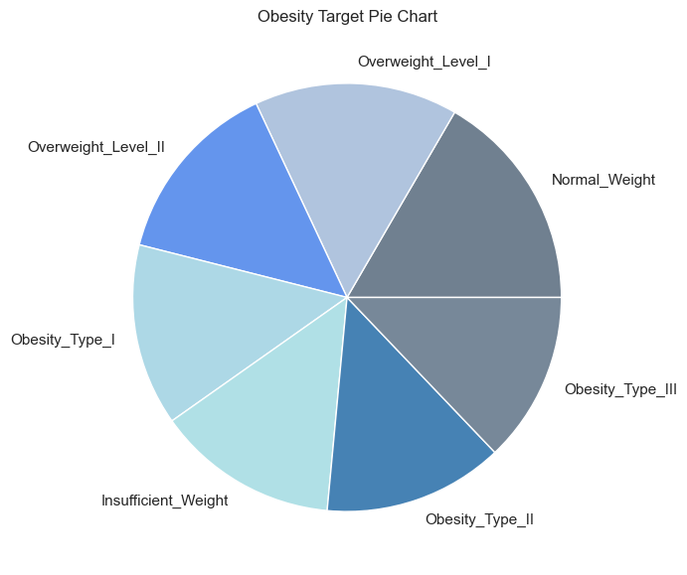
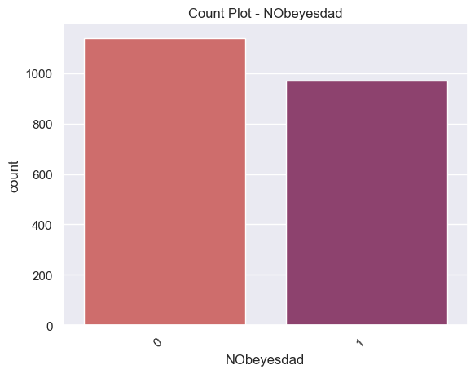
Obesity Target Pre-processing
Slight difference in the group counts, but sufficient data in each group to perform our analysis.
Number of non obese records = 1139
Number of obese records = 972
Notes:
Target consists of 7 groups: insufficient weight, normal weight, overweight levels 1-2, obesity types 1-3. Recast target data into 2 groups: obese (obesity levels 1-3) and not obese (remaining labels)
Distribution of target after preprocessing. Slight difference in the group counts, but sufficient data in each group to perform our analysis.

Slide 18
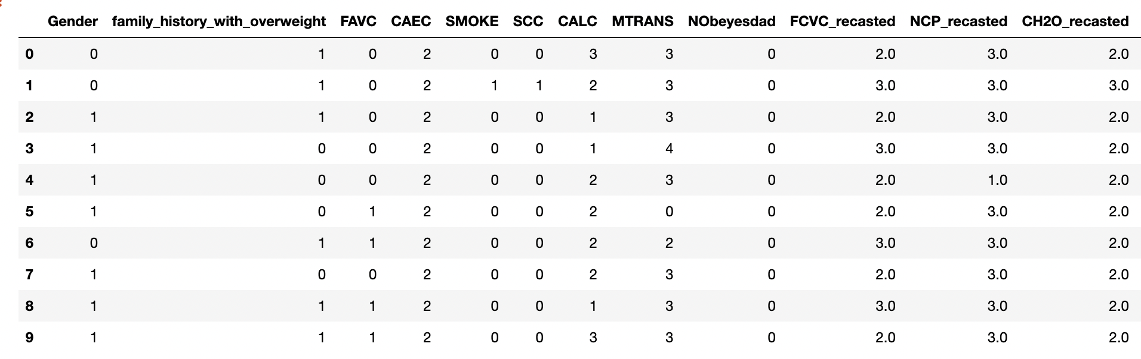
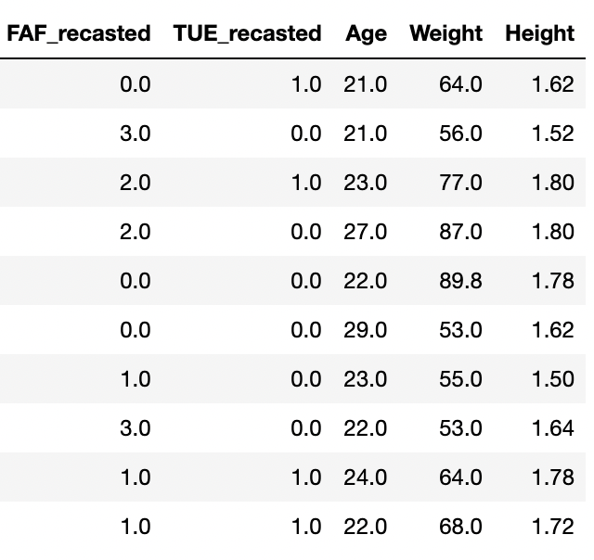
Preprocessing of Features
Categorical Variables
Numerical Variables
Encoded as an integer array for hypothesis testing.
Not recasted for hypothesis testing.

Slide 19
Hypothesis Testing & Feature Selection
03
Chi-Squared Test, Shapiro-Wilk Test, Mann-Whitney U Test

Slide 20
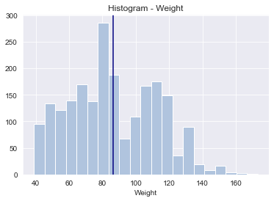
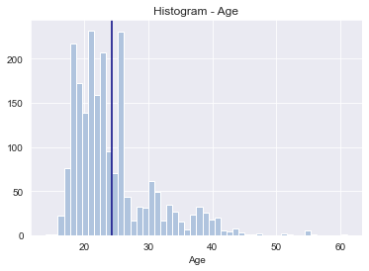
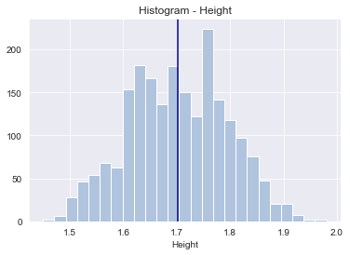
Shapiro-Wilk Test
H0: data are drawn from a normal distribution.
H1: data are not drawn from a normal distribution.

Slide 21
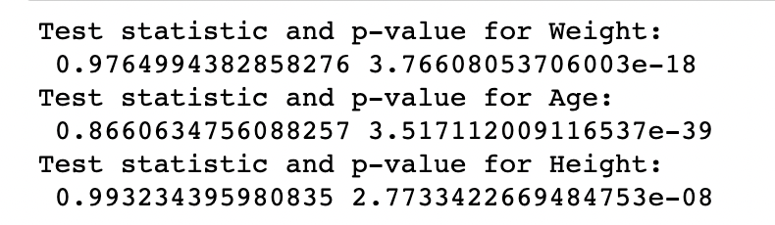
Shapiro-Wilk Test
H0: data are drawn from a normal distribution.
H1: data are not drawn from a normal distribution.
We reject the null hypothesis that Age, Height and Weight are drawn from a normal distribution.

Slide 22
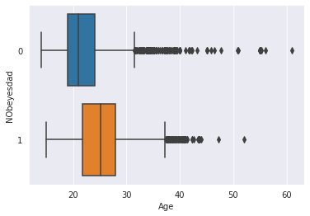
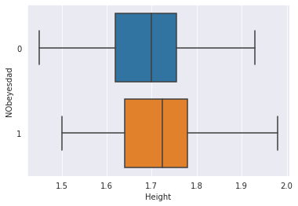
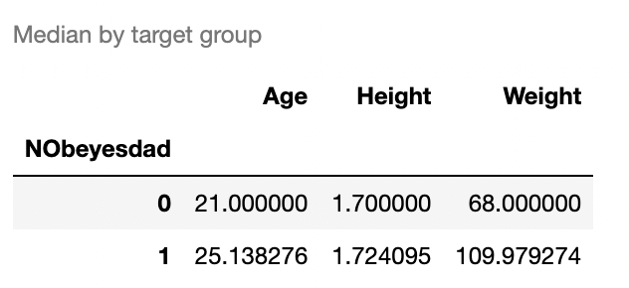
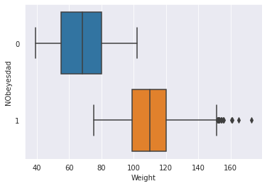
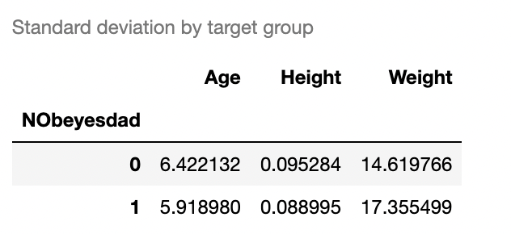
Mann-Whitney U Test
H0: ‘NObeyesedad’ & each numeric variable are independent
H1: ‘NObeyesedad’ & each numeric variable are not independent
Notes:
Since our numerical features are not sampled from normal distributions, we use the Mann-Whitney U test to compare the medians between groups.

Slide 23
Mann-Whitney U Test
H0: ‘NObeyesedad’ & each numeric variable are independent
H1: ‘NObeyesedad’ & each numeric variable are not independent
Per results, we reject the null hypothesis that age, height, and weight have no impact on obesity
Weight and height were dropped from our model given the relationship to mass body index; which was used to operationalize target variable

Slide 24
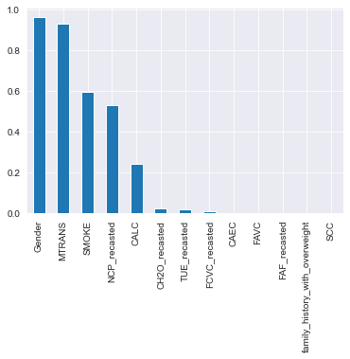
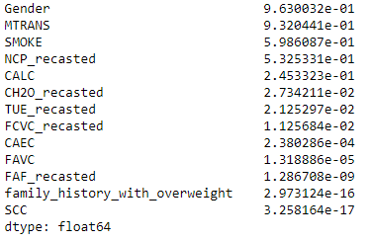
Chi-Squared
H0: ‘NObeyesedad’ & each factor variable are independent
H1: ‘NObeyesedad’ & each factor variable are not independent
For features with p < 0.05, we reject the null hypothesis that their relationship to the target is independent
Notes:
A chi-square test compares count data in different groups to their expected counts within each group. If the difference is statistically significant, we reject the null hypothesis that there is no relationship between the independent variable and the target.
CH2O: Consumption of water daily
TUE: Time using technology devices
FCVC: Frequency of consumption of vegetables
CAEC: Consumption of food between meals
FAVC: Frequent consumption of high caloric food
FAF: Physical activity frequency
family_history_with_overweight: Family history with overweight
SCC: Calories consumption monitoring

Slide 25
Modeling
04
Logistic Regression

Slide 26
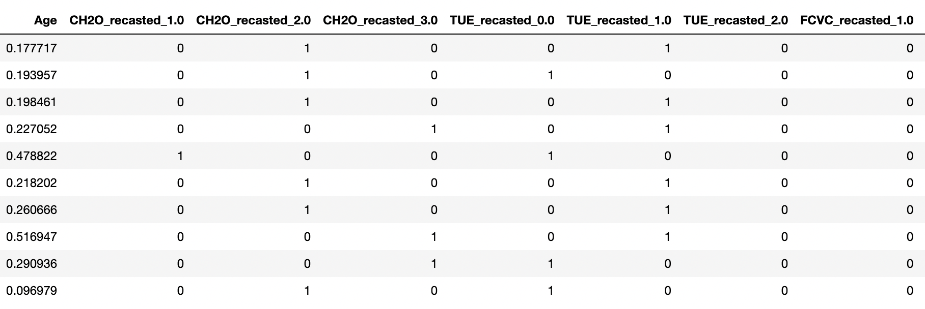
Additional Processing for Modeling
Categorical
Numerical
Dummy coded as individual binary variables.
Min-Max Scaled
Notes:
24 columns in total, 8 columns shown for purpose of presentation.

Slide 27
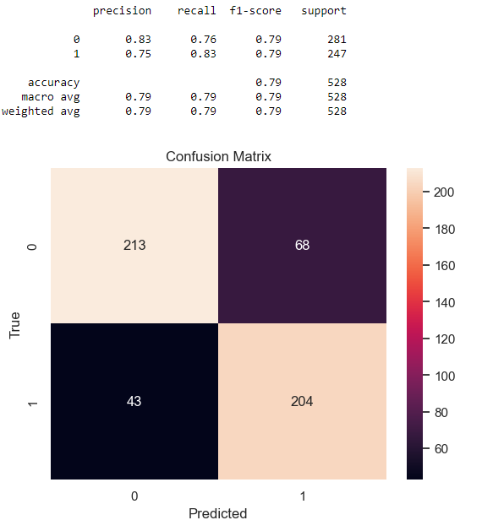
Logit Model - Results
Overall Model Accuracy: 79%
Obesity
Precision: 75%
Recall: 83%
Non-obese
Precision: 83%
Recall: 76%
True Obese: 204
True Non-Obese: 213
False Non-Obese: 43
False Obese: 68

Slide 28
Interpreting
Feature Importance
05
Features that impact obesity

Slide 29
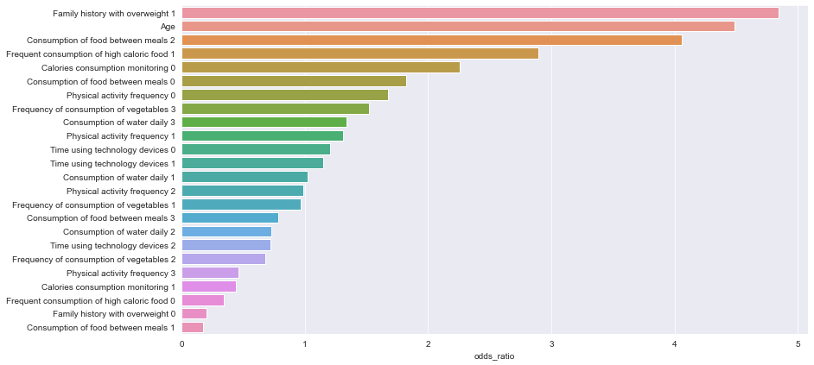
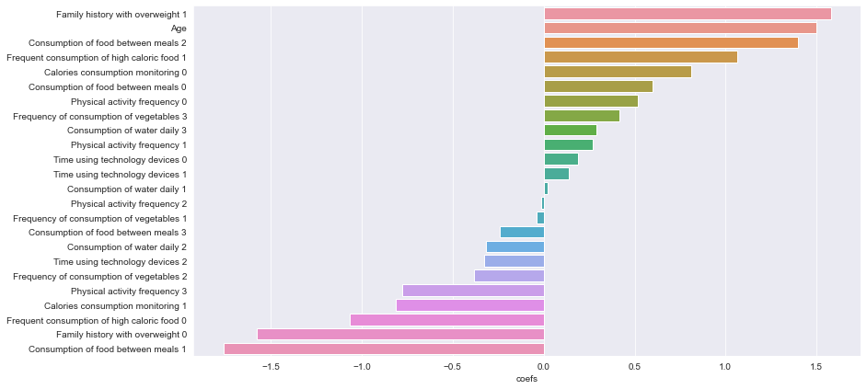
Feature Importance
Coefficients
Odds Ratios

Slide 30
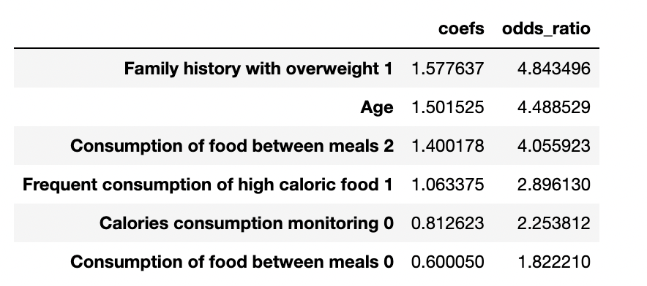
Based on Odds Ratios
Among those with a family history of overweight, the odds of obesity are 4.84 times the odds of obesity among those without a family history of overweight
The odds of obesity for every one unit increase in age is 4.48 times more likely
Among those that consume food between meals frequently, the odds of obesity are 4.05 times the odds of obesity among those that do not consume food between meals frequently

Slide 31

A Few General Recommendations:
Identify if there is a family history of overweight/obesity
Monitor your caloric intake as you increase in age
Limit snacking between meals
Be conscious of high caloric foods without nutritional value
Consult a physician if you believe you are at risk of obesity

